Slide 1

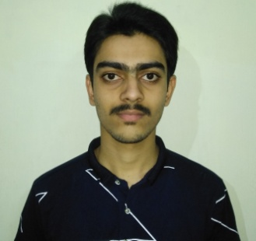
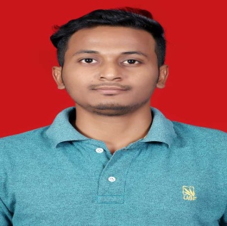
E-Book Store
Project ID:21236
By
Student 1: Biswajeet Padhi Roll No: CSE201712417
Student 2: Shyailesh Mishra
Roll No: CSE201710418
Under the guidance of
Mrs. Manali Sarkar
Biswajeet Padhi (Roll#CSE201712417) & Shyailesh Mishra (Roll#CSE201710418)
Notes:
B-TECH PROJECT MID-SEM PRESENTATION 2011
BY KHUSHBU KHAN & ISAN SAHOO

Slide 2
Outline
Introduction
Tools/Softwares
Architecture
Sequence Diagram
Features
References
Biswajeet Padhi (Roll#CSE201712417) & Shyailesh Mishra (Roll#CSE201710418)
Notes:
B-TECH PROJECT MID-SEM PRESENTATION 2011
BY KHUSHBU KHAN & ISAN SAHOO
2

Slide 3
Introduction
Convenience of E-Book over Physical Book
Hassle free reading
Taking Digital notes
Better Time utilization
Biswajeet Padhi (Roll#CSE201712417) & Shyailesh Mishra (Roll#CSE201710418)

Slide 4






Tools/Softwares
Frontend
React Js
Backend
Node Js
MongoDB
Express Js
Testing
Postman
IDE
Visual Studio Code
Biswajeet Padhi (Roll#CSE201712417) & Shyailesh Mishra (Roll#CSE201710418)

Slide 5
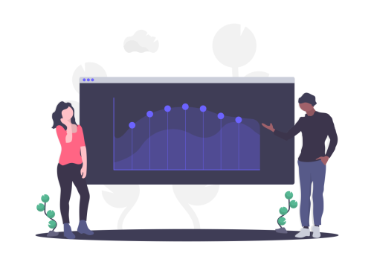
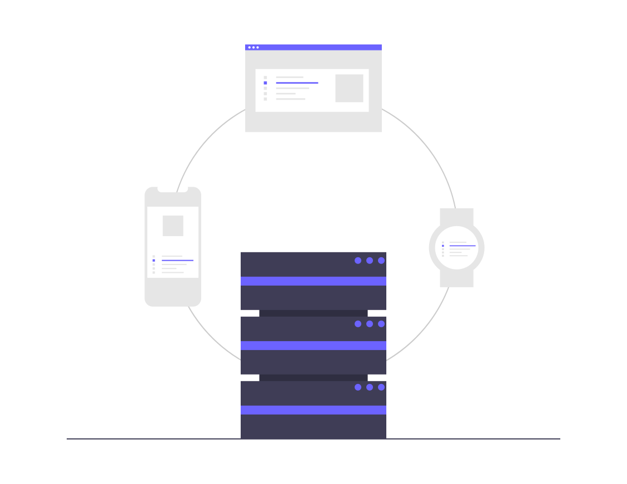

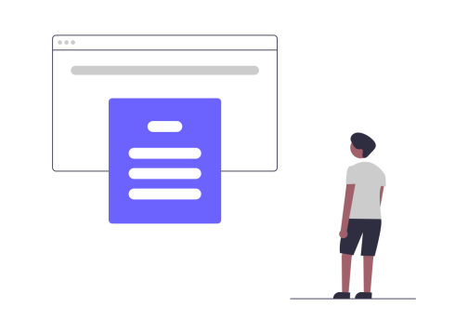
Architecture
Admin
Server
Database
Reader
Biswajeet Padhi (Roll#CSE201712417) & Shyailesh Mishra (Roll#CSE201710418)

Slide 6
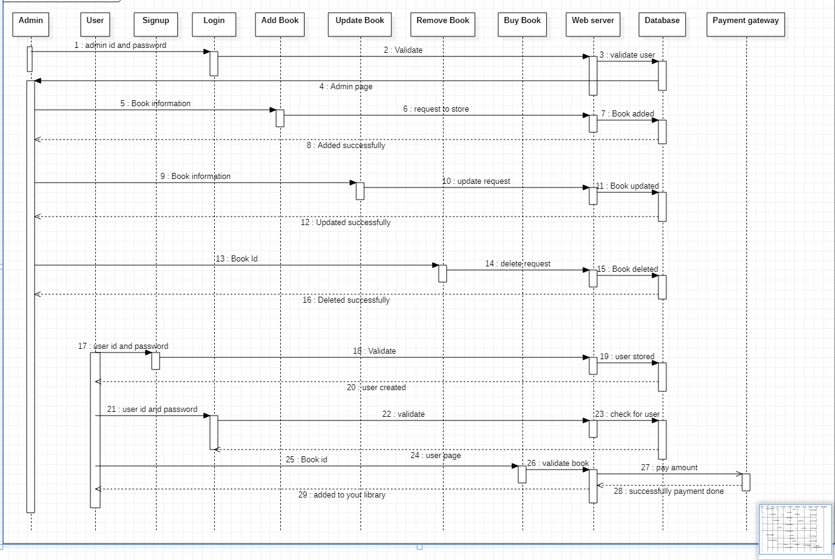
Sequence Diagram
Biswajeet Padhi (Roll#CSE201712417) & Shyailesh Mishra (Roll#CSE201710418)

Slide 7
Features
Admin
Upload new books
Update Books
Remove Books
Demand Analysis
User (Reader)
Search Books
Purchase Books
Note making
Reminder
Biswajeet Padhi (Roll#CSE201712417) & Shyailesh Mishra (Roll#CSE201710418)

Slide 8
Reference
[1] Kaplan, R. ed., 2012. Building and Managing E-book Collections: A How-to-do-it Manual for Librarians (No. 184). American Library Association.
[2] Gustman, S., Survivors of Shoah Visual History Foundation, 2000. Digital library system. U.S. Patent 6,092,080.
[3] Witten, Ian H., David Bainbridge, and David M. Nichols. How to build a digital library. Morgan Kaufmann, 2009.
Biswajeet Padhi (Roll#CSE201712417) & Shyailesh Mishra (Roll#CSE201710418)
Notes:
B-TECH PROJECT MID-SEM PRESENTATION 2011
BY KHUSHBU KHAN & ISAN SAHOO
8

